Slide 1
Advance Techniques

Slide 2
Creating Shaders
1. Create shader objects ( gl.createShader() ).
2. Store the shader programs (to avoid confusion, we refer to them as “source code”) in the shader objects ( g.shaderSource() ).
3. Compile the shader objects ( gl.compileShader() ).
4. Create a program object ( gl.createProgram() ).
5. Attach the shader objects to the program object ( gl.attachShader() ).
6. Link the program object ( gl.linkProgram() ).
7. Tell the WebGL system the program object to be used ( gl.useProgram() ).

Slide 3
Creating Shaders
Two types of objects are necessary to use shaders:
Shader object: A shader object manages a vertex shader or a fragment shader. One shader object is created per shader.
Program object: A program object is a container that manages the shader objects. A vertex shader object and a fragment shader object (two shader objects in total)must be attached to a program object in WebGL.

Slide 4
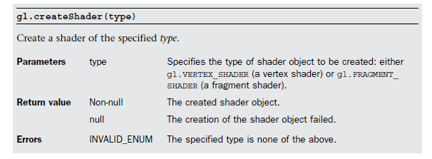
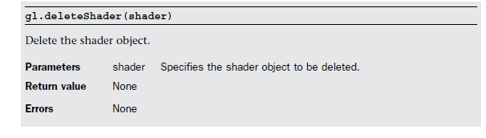

Slide 5
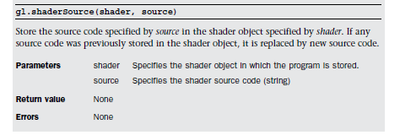

Slide 6
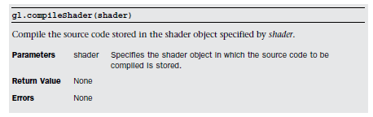
When executing gl.compileShader() , it is possible a compilation error occurs due to mistakes in the source code. You can check for such errors, as well as the status of the shader object, using gl.getShaderParameter() .

Slide 7
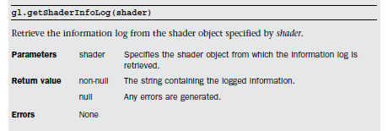

Slide 8
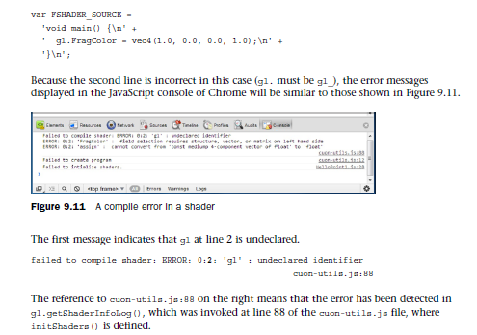

Slide 9
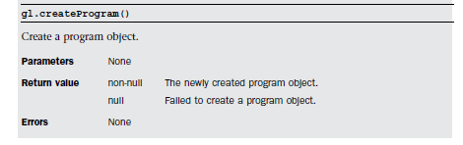
A program object is a container to store the shader objects and is created by gl.createProgram()

Slide 10
Switching Shaders
1. Prepare the shaders to draw an object shaded with a single color.
2. Prepare the shaders to draw an object with a texture image.
3. Create a program object that has the shaders from step 1 with createProgram() .
4. Create a program object that has the shaders from step 2 with createProgram() .
5. Specify the program object created by step 3 with gl.useProgram() .
6. Enable the buffer object after assigning it to the attribute variables.
7. Draw a cube (drawn in a single color).
8. Specify the program object created in step 4 using gl.useProgram() .
9. Enable the buffer object after assigning it to the attribute variables.
10. Draw a cube (texture is pasted).

Slide 11
Fog (Atmospheric Effect)
There are various ways to calculate fog, but here we will use a linear computation ( linear fog ).
The linear fog method determines the density of the fog by setting the starting point (the distance where the object starts to become hazy) and the end point (where the object is completely obscured). The density of the fog between these points is changed linearly.

Slide 12

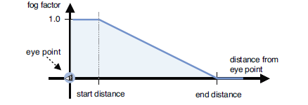


Slide 13
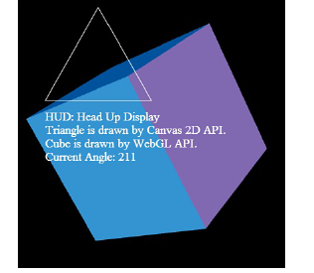
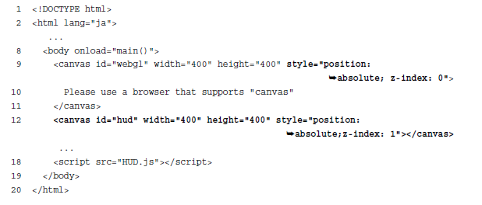
HUD (Head Up Display)

Slide 14
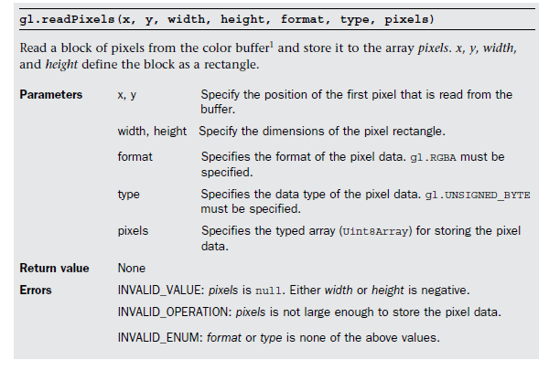
Reading Pixel RunTime (PickObject.js)

